Slide 1

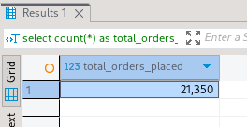
1] To Retrieve the total number of Sales

Slide 2
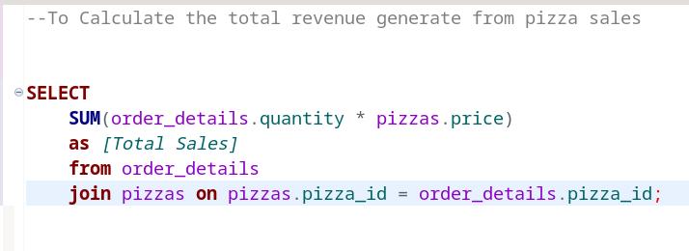
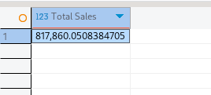
2] To Calculate the total revenue generate from pizza sales

Slide 3
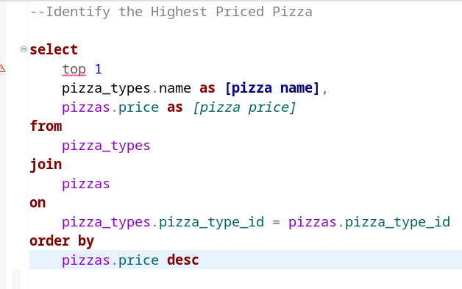

3] Identify the Highest Priced Pizza

Slide 4
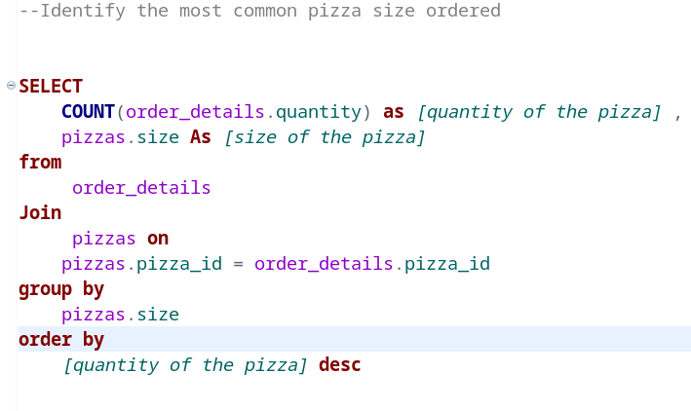
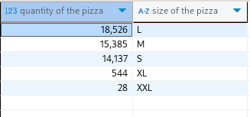
4] Identify the most common pizza size ordered

Slide 5
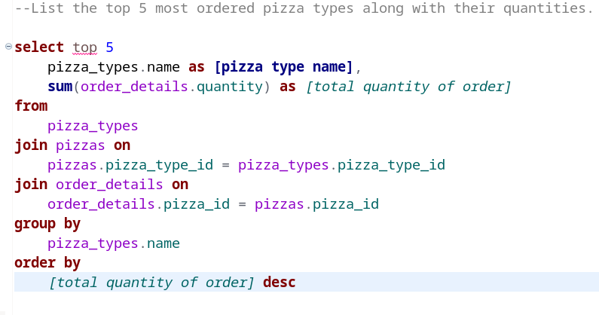
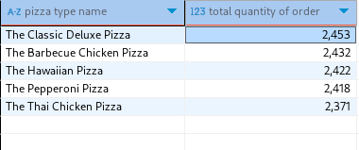
5] List the top 5 most ordered pizza types along with their quantities.

